Slide 1
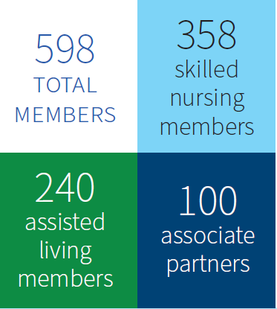

Slide 4
Facilities are Implementing Strong Recruitment and Retention Efforts
Primary Obstacle: Lack of Interested or Qualified Candidates
94% of facilities say it is difficult to recruit new staff; 67% cite a lack of interested or qualified candidates as an extremely big obstacle.
78% have offered bonuses, including sign-on bonuses.
70% have promoted staff within their facilities.
69% have paid for staff training and education.

Slide 5
Nursing Homes are Limiting Admissions, Concerned About Closures
46% of nursing homes have limited new admissions:
38% have had to turn away potential residents weekly or monthly, and
7% have had to turn away potential residents daily.
Nearly 20% have closed a unit, wing or floor because of labor challenges.
66% of facilities are concerned that if workforce challenges persist, they may have to close their facility.

Slide 7
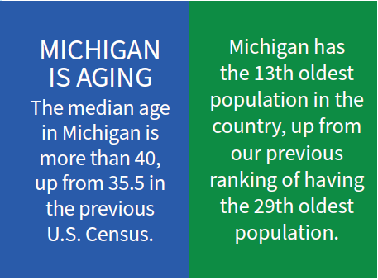

Slide 8
Major Changes to the Skilled Nursing Profession
Centers For Medicare and Medicaid Services (CMS) Nursing Facility Staffing Rule
Medicaid Rate Reform
HIDE-SNP – Managed Medicaid for Long-Term Supports and Services (MLTSS)

Slide 9
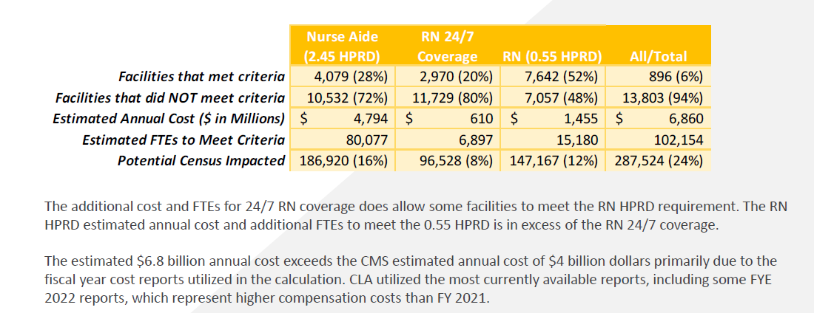
CMS Nursing Facility Staffing Rule

Slide 10
CMS Nursing Facility Staffing Rule – Michigan Impact
Estimated cost to the state of Michigan - $145 million annually

Slide 11
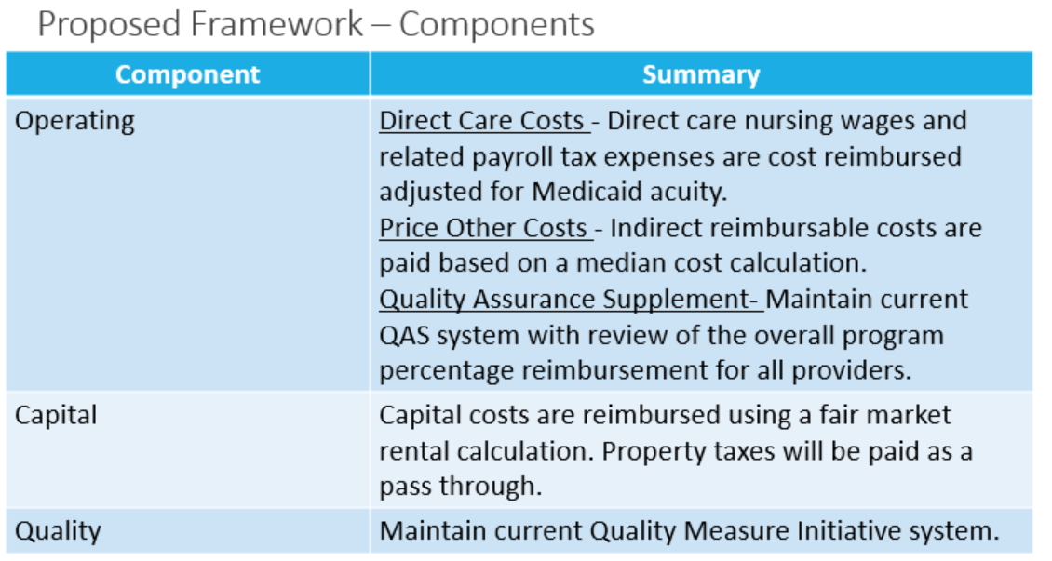
Medicaid Rate Reform

Slide 12
MI Health Link HIDE SNP
HIDE SNP = Highly Integrated Duals Eligible Special Needs Plan
Brings Managed Medicaid Long-Term Services and Supports (MLTSS) to Michigan.

Slide 13
2025 State Fiscal Year Budget
Direct Care Worker and Non-Clinical Worker Wage Increase – must be sustainable.
Funding to assist providers and MDHHS to a new Medicaid reimbursement system for nursing facility residents.
Potential boilerplate – updates to the Michigan Medicaid Policy Manual to reflect current occupancy and operational realities.

